Slide 1
Mutual Aid Database
Milestone 2.0
Application by: Dolma Rawat, Daniel Pham, Soren Laskin & Komi Adomayakpor

Slide 2
Refresher of milestone 2
New changes added
Feedback implementation
Demo
Questions
Notes:
Soren
Go over what our project is and its purpose
Talk about what we are going to talk about in our presentation

Slide 3
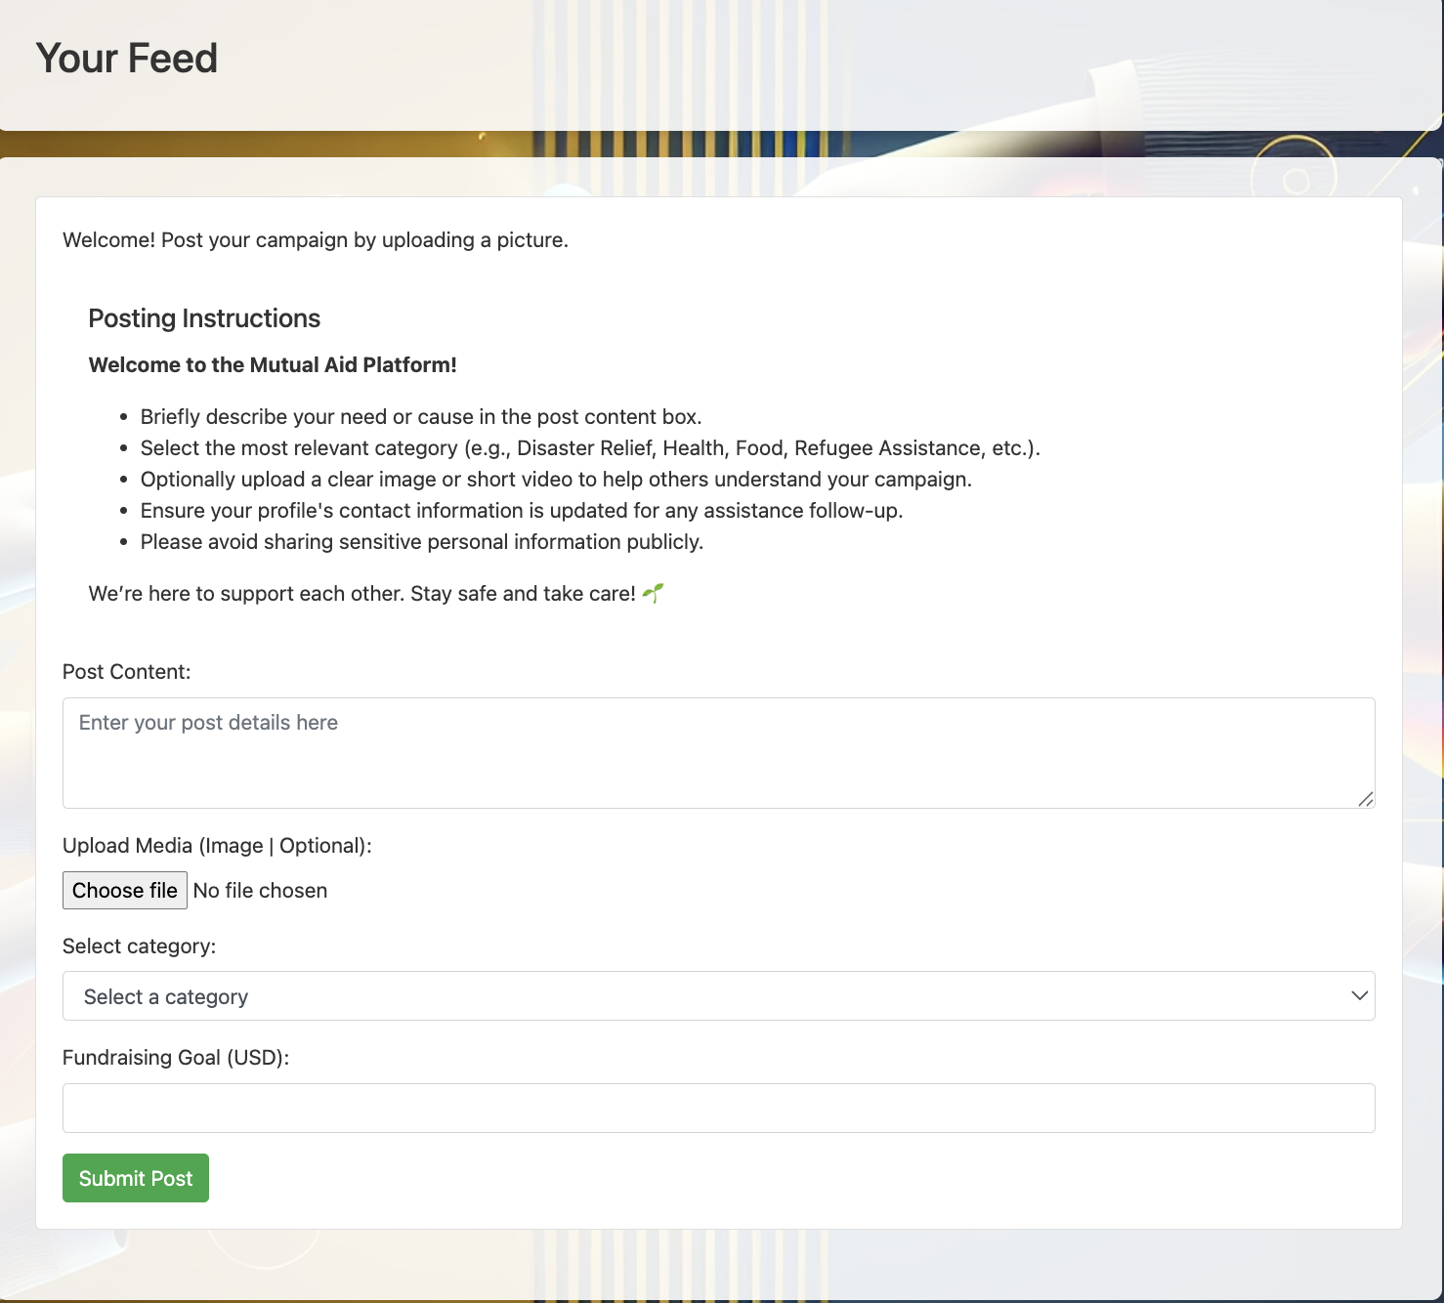
Feedback from Milestone 1
User Story - As a user affected by a natural disaster, I want to post a fundraising campaign with a title, description and percentage towards financial goal.
Notes:
Soren

Slide 4
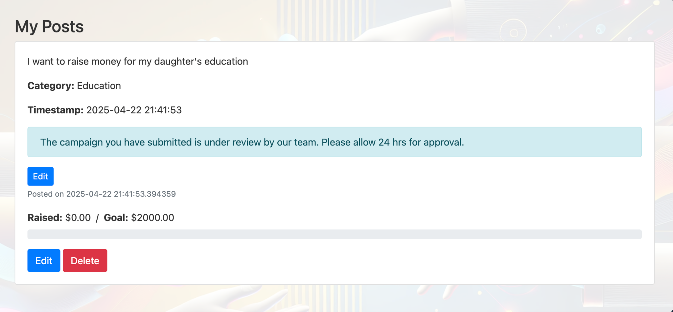
Notes:
Dan

Slide 5
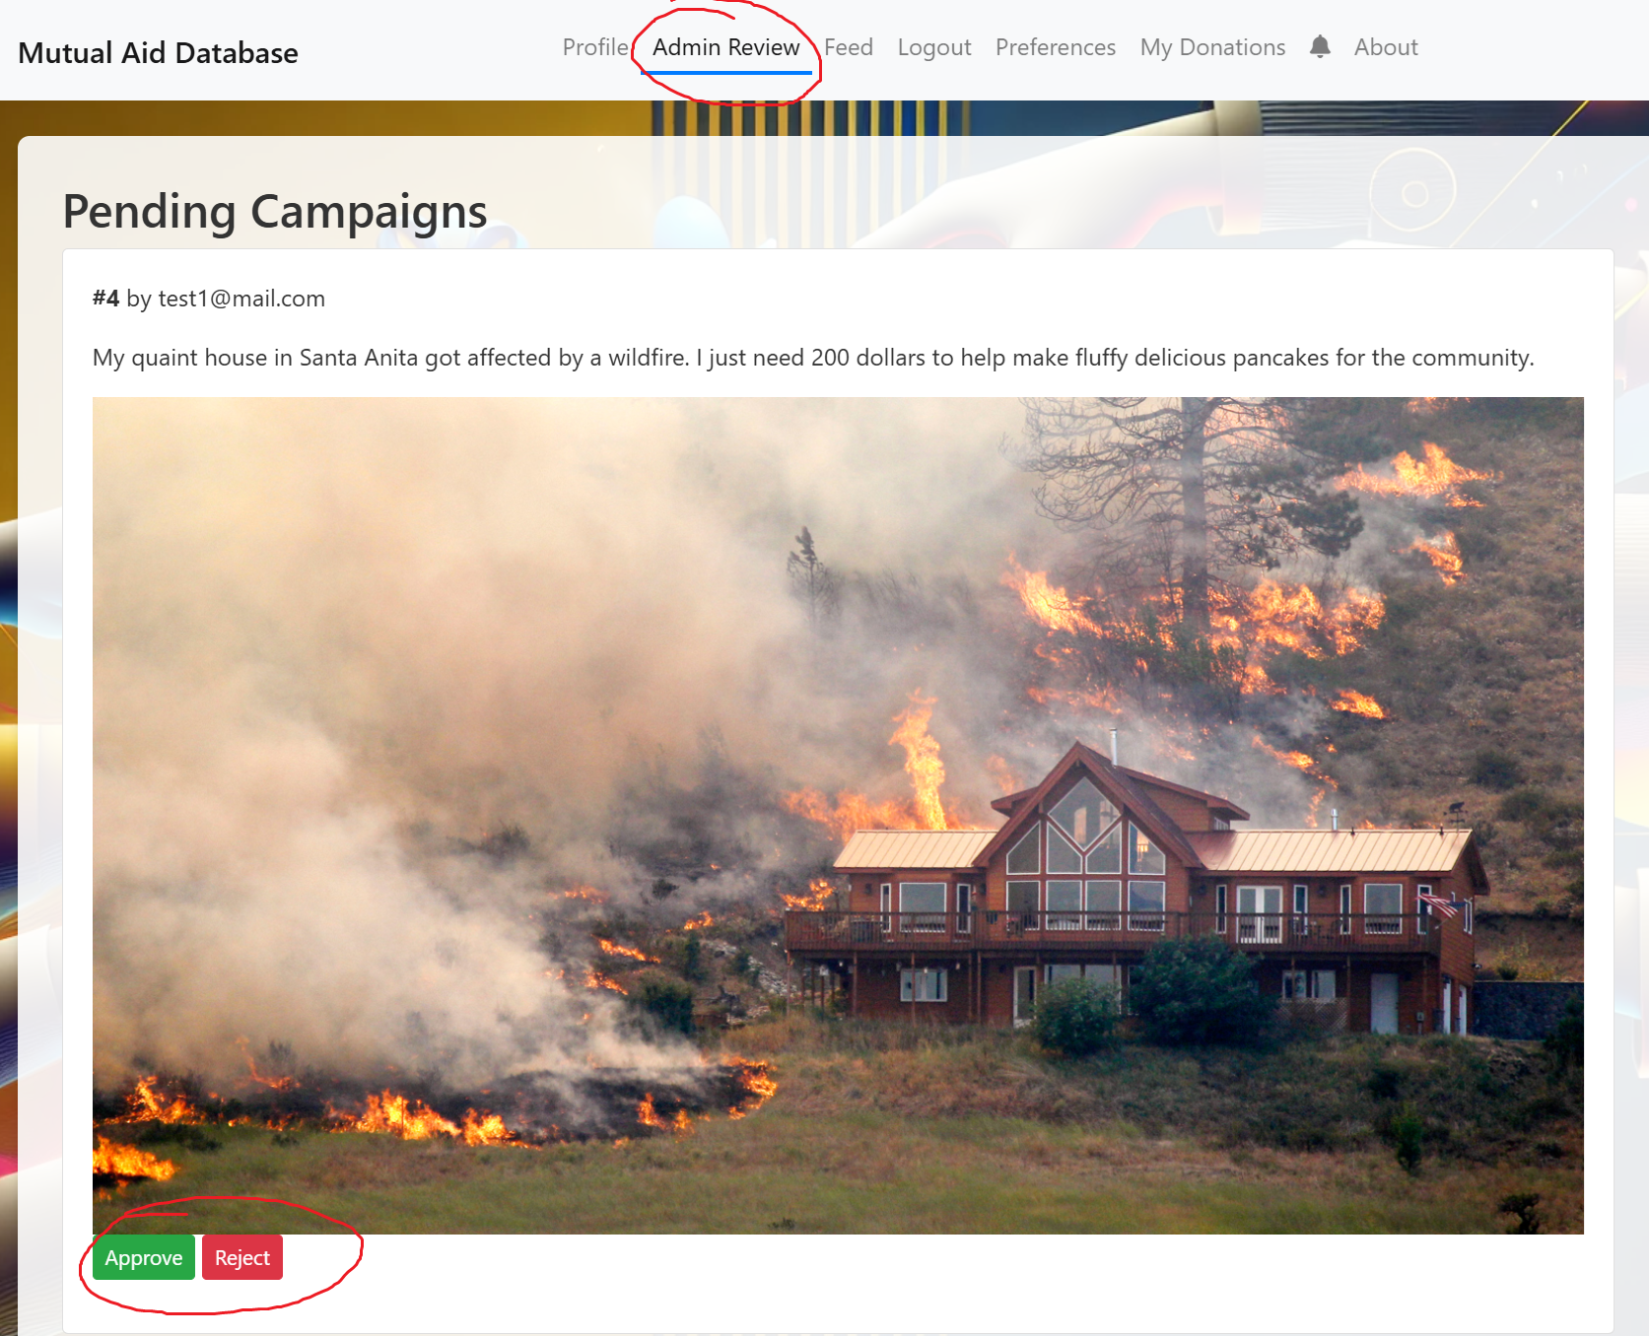
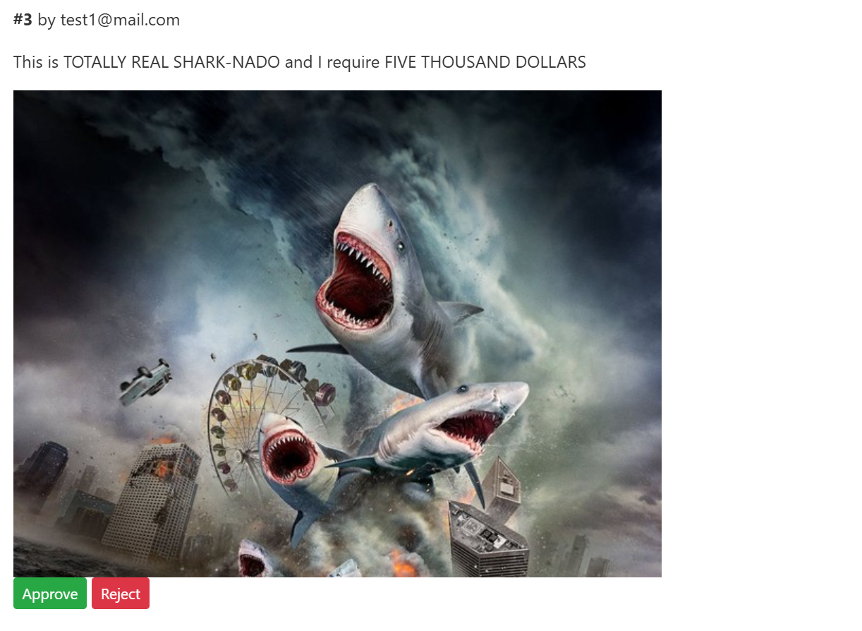
Feedback from milestone 1
Feedback: “...could be abused if stories are non-validated”
User Story: “As a developer, I want to review new campaigns to filter out inappropriate submissions”
Notes:
Dan Talk about the bots flooding the database -> admin user to moderate posts before they are publicly displayed

Slide 6
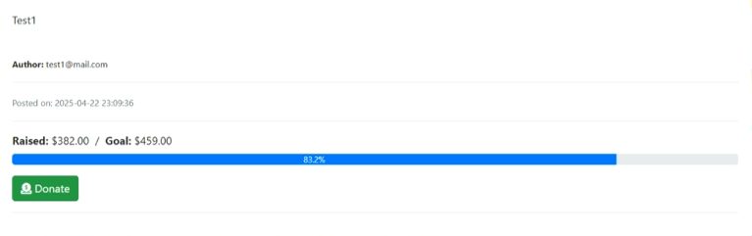
Feedback from Milestone 1
User Story - As a donor, I want to be able to see where my donations go towards on successful campaigns
Notes:
Dan

Slide 7
Feedback from milestone 1
“...and it is important that we are able to follow projects and receive updates on posts without having to visit each project page. We might want to keep an eye on several campaigns and decide at a later date whether or not to help fund it.”
Notes:
Dan
Feedback -> notifications tab

Slide 8
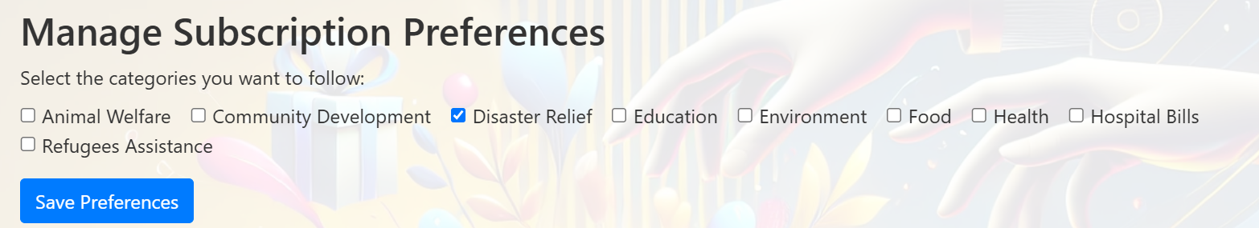
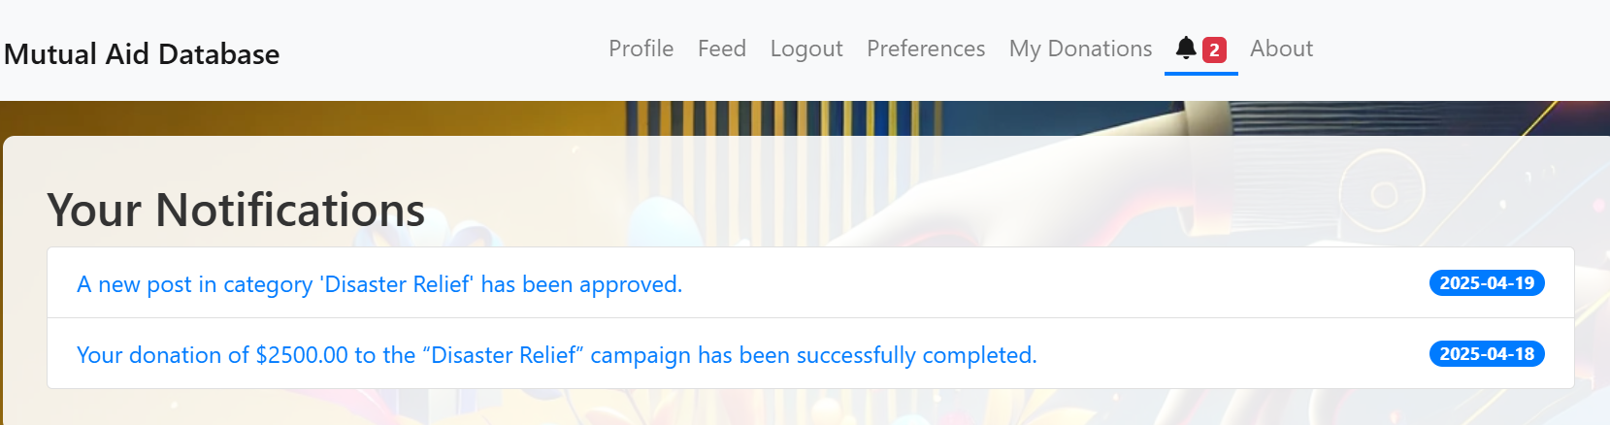
Screenshots of the functionalities created:
Notes:
Dan
Other new integrations: Filters to decide what type of posts you would like to see
Notifications for donations and posts

Slide 9
Design Mockup
Notes:
Dolma

Slide 10
Agile Methods
Notes:
Agile methods structure (Dolma)

Slide 11
Extreme Programming(XP)/Repo Structure
Pair Programming to decrease the amount of devs pushing old, broken or untested code
Issues with synchronous coding on github, so we worked with pairs and confirmed it with one person to push
Created a different branch- Dev branch and let one person push to main, main was always working and tested code.
Notes:
Dolma This satisfies G. repo structure

Slide 12
Iterations:
Iteration 1: Built out the captcha feature for the login functionality
Iteration 2: Focused on having an instructions page for the posting content for the users
Iteration 3: Created categories for the posts based on what the content is about
Iteration 4: Created a review functionality for the admin to approve the posts before it is posted on the main feed
Iteration 5: Created an in-app solution to contribute to donations for all users.
Notes:
Dolma

Slide 13
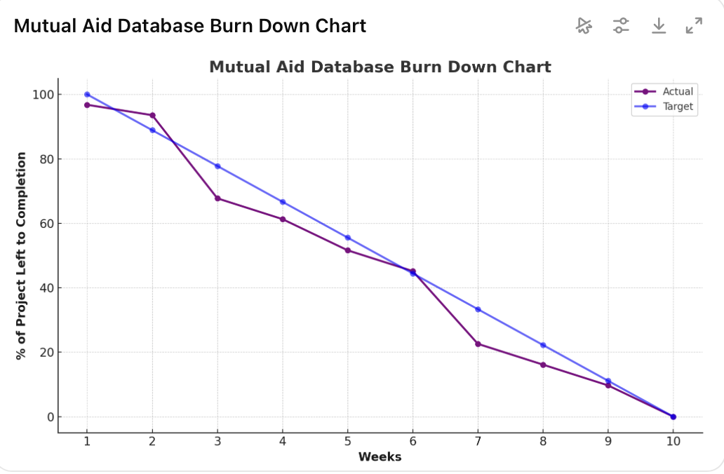
Burn down chart and recording the meetings
Notes:
Dolma

Slide 14
Testing/refining code
Test Name | Test files | Test Inclusions | Description
Test login | test_login.py | Valid credentials, invalid credentials, session creation | Validates user authentication flow.
Test register | test_register.py | New user registration, duplicate email/username check | Ensures new users can register successfully.
Test profile | test_profile.py | Authenticated access, profile update, unauthorized access | Checks access and updates to user profiles.
Test admin | test_admin.py | Admin login, admin dashboard access, permissions | Verifies admin-only features are protected.
Test donations | test_donations.py | Making a donation, viewing donation history, invalid input | Tests donation flow and related records.
Test notifications | test_notifications.py | Sending, receiving, and reading notifications | Ensures users receive relevant notifications.
Notes:
Talk about different tests and their functions:
(Soren can do but anyone is welcome to take)

Slide 15
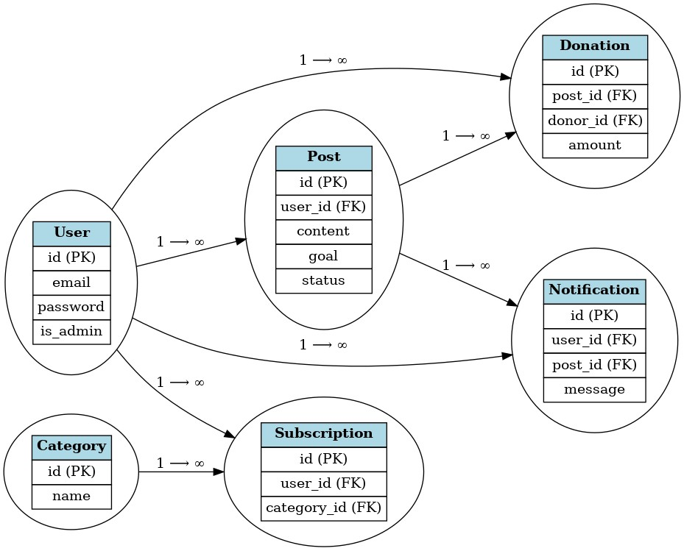
How the information interacts
Notes:
Komi

Slide 16
Demo!
Notes:
On how we will present the demo:
Soren will do general things + donations button
Dolma will present new changes in filters
Dan will present admin profile and the things that go along with that (okaying posts, taking down posts)
Komi will go over tests

Slide 17
Challenges/Successes
Challenges
Hard to schedule meetings
Inexperience with github, had to revert many changes and create another
Successes
Successfully integrate feedback
Pinpoint core functionalities and iterate on smaller ideas
Able to add in ideas from every developer and solve problems collaboratively
Notes:
Dan

Slide 18
Things we learned/Moving forward
Communication and collaboration is key since even in coding, there are creativity involved. Collecting all of those styles into one product is challenging.
It is important to keep track of the changes made by each individual and pull the changes in GitHub with the latest version
Creating tests are as important as creating features!
Organization is important
Notes:
Soren
If this project were to continue after this semester, what are some changes we would take to further refine the project
Short and longer term goals
Satisfies “c. 3 most important things learned”

Slide 19
Any questions?

